Slide 1
Time to Make a Choice
Control Structures, pt. 1

Slide 2
Overview
3 big ideas
LPC
Coming next
tl;dl

Slide 3
Simplicity uses assumptions
Notes:
In this class, as in many other areas, we start simple.
We make some assumptions and ignore some possibilities to create a simple model of what we are trying to learn or do.
Narrow focus
Ignore most of environment
Just solve a single part of the problem
Make assumptions
We use a simple model with a right answer because it is:
Easier to learn
Easier to solve
Easier to grade

Slide 4
Simple Code Process
Thing 1
Thing 2
Thing 3
Thing 4
Thing 5
Notes:
Up to this point of the class, your code has been similar to this simplified model.
Your code up to this point has been similar - artificially simplified so that all instructions could be planned out in advance by you (a programmer). This is not the best use of either your time/energy/effort or the computer(s) capabilities. But it is where we have to start …
Your code has assumed rational user behavior …
Your code has been a cylindrical penguin in a vacuum without air resistance.
But now … it’s time to notice & account for the environment it is in …
And that means that the simplified model is in trouble.

Slide 5
Assumptions can break your code

Slide 6
Assumptions getting interesting …
Assume frictionless space
Assume zero air resistance
(personal favorite) Assume that a penguin is a circular cylinder
Notes:
Using a simple model - and focusing on a specific task - requires making assumptions. And sometimes

Slide 7
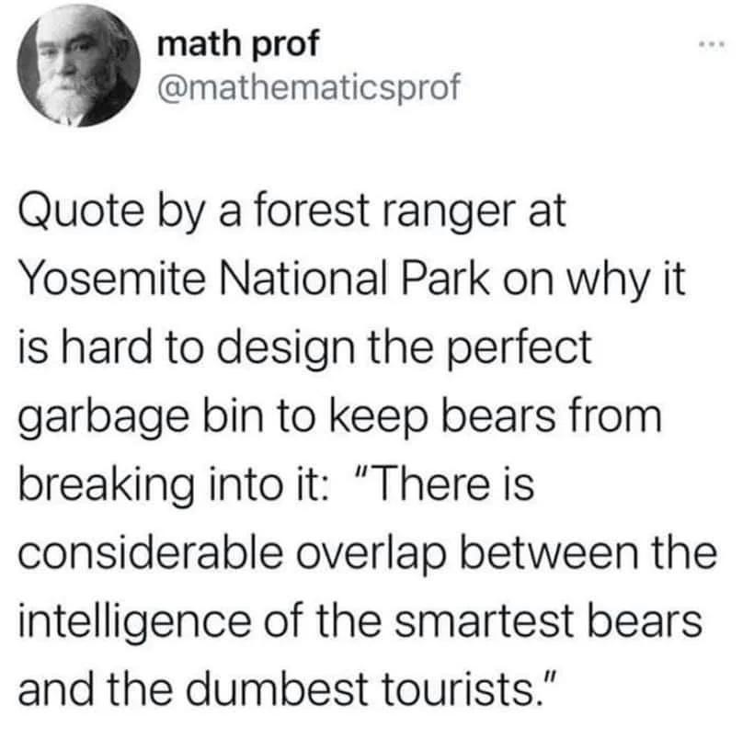

Slide 8
Assumptions* can break your code
* without handling
Notes:
The goal isn’t to stop making assumptions … it’s to allow the code to handle behavior that doesn’t *fit* the assumptions …
We need ways to check user behavior/input against our assumptions so that the code doesn’t get killed by odd behavior (because there definitely will be odd behavior)

Slide 9
Code needs to notice and react to users & environment

Slide 10
Noticing & Reacting: Make a Choice
Notes:
“Once we start considering the psychology of our [participants/users] … our [simplified] model is in trouble”
We can start with a simple problem (i.e. Lost Immortals)
If we have a simple problem and no variables we can plan out all of the steps in advance.
However, as soon as we add variables in the terrain, the individuals, or anything else, the simplified model gets much messier … but also much. more. fun
Those black boxes can truly reveal some strange choices and help to make programmers aware of assumptions that they didn’t realize they were making

Slide 11
Evaluation: if and else
Ask for input
Condition?
yes
no

Slide 12
Evaluation: elif
Ask for input
Condition?
yes
no
Condition?
yes
no

Slide 13
Evaluation: more elif
Ask for input
?
yes
no
?
yes
no
?
yes
no
?
yes
no

Slide 14
Evaluation: case
Ask for input
CASE:

Slide 15
Participatory Live Coding
Notes:
Me coding TAP (think-aloud protocol) and including errors (planned or not) so I can talk through the debugging process…
Have them say what comes next - correct me (maybe not for the teaching demo though?)

Slide 16
Error handling
Notes:
Include the issue for case - it isn’t in that version
How do we look for problems?
How else can we do this selection process?

Slide 17
Coming next…
Notes:
Next class we will be discussing loop structures (while, until, etc.) including how to escape them (think Sheldon Friendship Algorithm)

Slide 18
tl;dl
Notes:
It’s time for the too long; didn’t listen:
It’s time to ask for input.
It’s time to notice what happens.
It’s time to react.
Your code is a reflection of you - and it’s time to make a choice.

Slide 19
8 before
4 minutes: brainstorm groups of 3-5
What does this assignment need to include/do/change in order to be successful?
4 minutes: making a list/board as a class
What does this situation need?
What questions do you have?
Notes:
What would success look like on this assignment?
How would we know if it was good?
What does this situation need?

